Slide 1

IST – ULisboa
CIVIL ENGINEERING, ARCHITECTURE
& GEO-RESOURCES DEPARTMENT

Slide 2
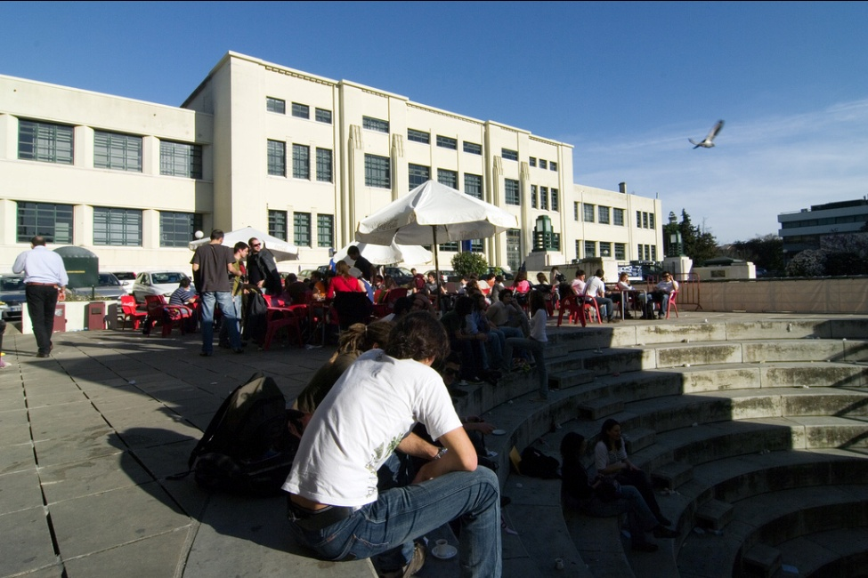
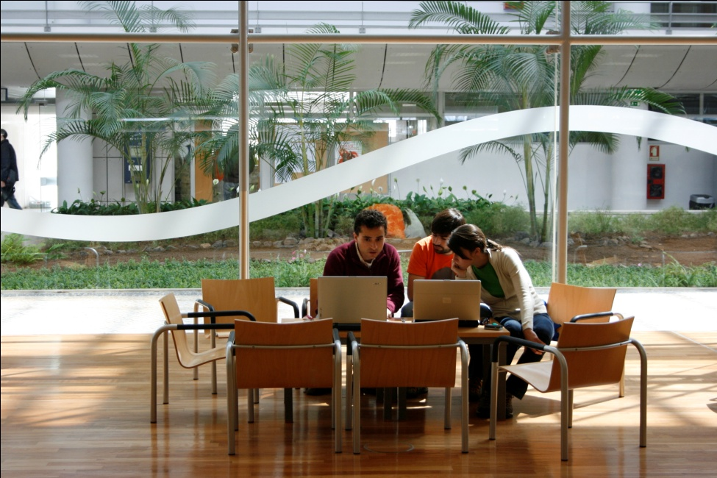
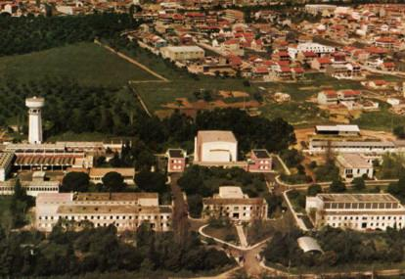


ABOUT INSTITUTO SUPERIOR TÉCNICO
Campus Alameda
Located in one of the central-Lisbon, the Alameda Campus benefits from a transport network that facilitates mobility to all the areas of the city. In its vicinity, there are many shopping, leisure, culture, entertaining and sports areas.
Total area: 107 137 m2
Lisbon
Campus TagusPark
Integrated into the Science and Technology Park, known as Taguspark, one of the biggest and most important technological parks across the country, mainly in the area of ICT.
Oeiras
Total area: 17 186 m2
Campus Loures
One of the most important technology parks in the country, mainly in the area of Nuclear Science. Incorporates the Portuguese Research Reactor and the Radiological Protection and Safety Unit.
Loures

Slide 3
ABOUT INSTITUTO SUPERIOR TÉCNICO
Facts & Figures
Organization
10 Departments 3 Platforms (Energy, Environ., Nano Tech.)
Certified programs
1st cycle: 19 MSc: 28 PhD: 32
Research 28 research units Over 1300 PhD researchers
Students | 11,458
1st cycle | 56%
Masters and PhD | 44%
Foreign MSc students | 13%
Foreign PhD students | 21%
Teaching Language (MSc, PhD) | Eng
Faculty | 871
Staff | 718
44%
56%
1st cycle students

Slide 4
ABOUT INSTITUTO SUPERIOR TÉCNICO
Joint Degrees
MIT
(Massachusetts Institute of Technology)
CMU
(Carnegie Mellon University)
UT-Austin
(University of Texas at Austin)
EPFL
(École Polytechnique Fédérale de Lausanne)
TIME
  Politecnico di Milano; Università Padova; Università Trento; Moscow; Écoles Centrales Paris, Lille, Lyon, Nantes.
CLUSTER
  KTH (Sweden), UPC (Spain), AALTO (Finland), UCLouvain (BE)
and MORE …
  TUDelft, U São Paulo, SupAero, UFRJ, UniCAMP, …

Slide 5

ABOUT INSTITUTO SUPERIOR TÉCNICO
Participation in FP7
PT
IST
1788
363
SUBMITTED PROPOSALS
364
134
APPROVED PROPOSALS
19%
37%
SUCCESS RATE

Slide 6

ABOUT INSTITUTO SUPERIOR TÉCNICO
Participation in H2020
198
SUBMITTED PROPOSALS
20
APPROVED PROPOSALS
H2020
Until May 2016
10%
SUCCESS RATE

Slide 7
ABOUT INSTITUTO SUPERIOR TÉCNICO
Rankings (2016-2017)
World
EU
PT
Academic Ranking of World Universities - Shanghai (Engineering) | 51-75 | 15 | 1
Academic Ranking of World Universities - Shanghai (Civ. Eng.) | 43 | 7 | 1
National Taiwan University Ranking (Engineering) | 103 | 17 | 1
National Taiwan University Ranking (Civ. Eng.) | 28 | 6 | 1
U.S. News Best Global Universities (Engineering) | 58 | 13 | 1
University Ranking by Academic Performance - URAP (Global*) | 116 | 44 | 1
SCImago Institutions Rankings - Research (Output) | 167 | 59 | 1
2016 Best Global Universities Rankings in Engineering, TOP 15 in Europe
* Global - All domains covered (e.g. Agriculture, Medicine, Social Sciences, etc.)

Slide 8






ABOUT INSTITUTO SUPERIOR TÉCNICO
Participation in Academic Networks
CLUSTER - Consortium Linking Universities of Science and Technology for Education and Research
TIME - Top Industrial Managers for Europe
CESAER - Conference of European Schools for Advanced Engineering Education and Research
CINDA - Centro Interuniversitario de Desarrollo
SEFI - European Society for Engineering Education
ATHENS - Advanced Technology Higher Education Network

Slide 9
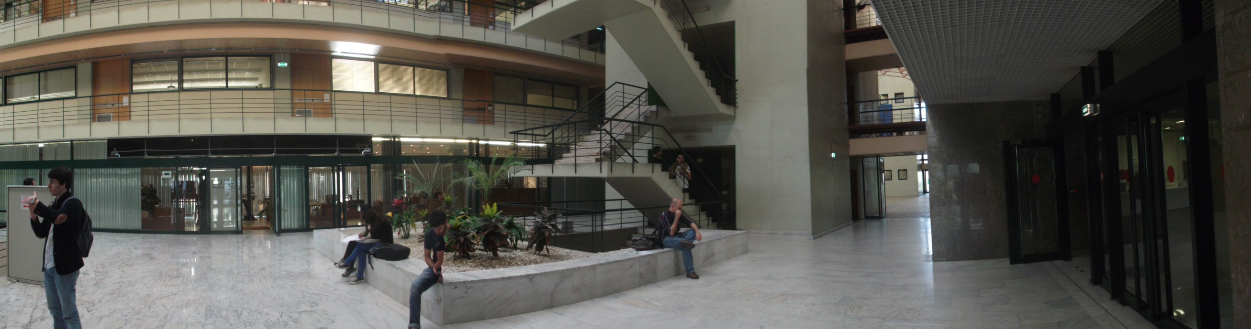
ABOUT DECivil
DECivil was established as a CE Department in 1911, expanded to host other degrees (namely, Architecture in 1998) and merged in 2008 with the Mining and Georesources Department (also established in 1911).
DECivil is now the largest Department of IST, with:
1962 MSc students, 240 PhD students and 135 faculty members, engaged in 12 MSc and 7 PhD programs.

Slide 10
RESEARCH AT DECivil
  Research at DECivil was well-established in the 1940’s (‘New’ campus).
  The research staff was used to create LNEC (1946) for the support of the National Infrastructure Plan (network of hydroelectric dams, …).
  LNEC became a highly successful research institution in the 1960’s and, conversely, research at DECivil virtually disappeared in that period (similar patterns are found in other areas).
  Reinvestment in university-based research happened in the 1970’s (3rd Republic), when three research units were created, namely CESUR (1975), ICIST (1975, …) and CEHIDRO (1981).
  A strong collaboration LNEC developed in the 1980’s and led to the protocolled use of LNEC’s excellent experimental facilities, under a policy of on non-duplication of heavy equipment / large facilities.

Slide 11
Faculty Members – 134 (full time equivalent)
BSc and MSc Students: ≈ 2500
Civil Engineering: ≈ 1719
Architecture ≈ 484
Others ≈ 295
Researchers/ research grants – 47
PhD students – 203
Post-Doc researchers – 15
DECivil
Facts & Figures

Slide 12
DECivil
Scientific Areas
Architecture
Construction
Geotechnics
Hydraulics, environment and water resources
Mining and geo-resources
Structural mechanics and structures
Urban and regional systems

Slide 13
DECivil
Degrees
Integrated Master Degrees
Architecture
Civil Engineering
Environmental Engineering (in co-operation)
BSc Degree (1st cycle)
Mining and Geological Engineering
Master Degrees (2nd cycle)
Mining and Geological Engineering
Petroleum Engineering
Transport Infrastructure Engineering
Transport Planning and Operation
Urban Planning and Territorial Management

Slide 14





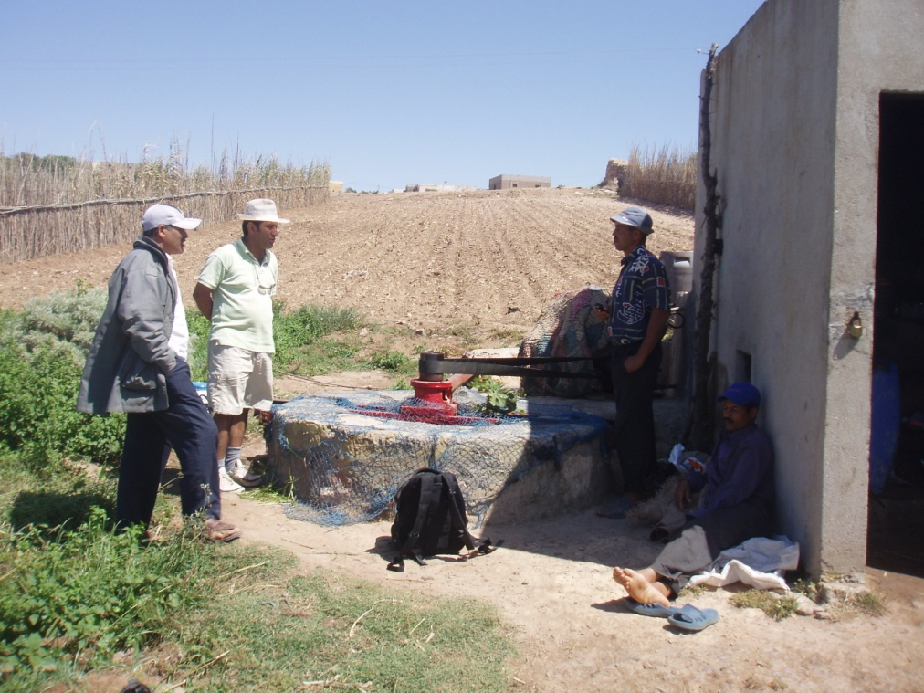
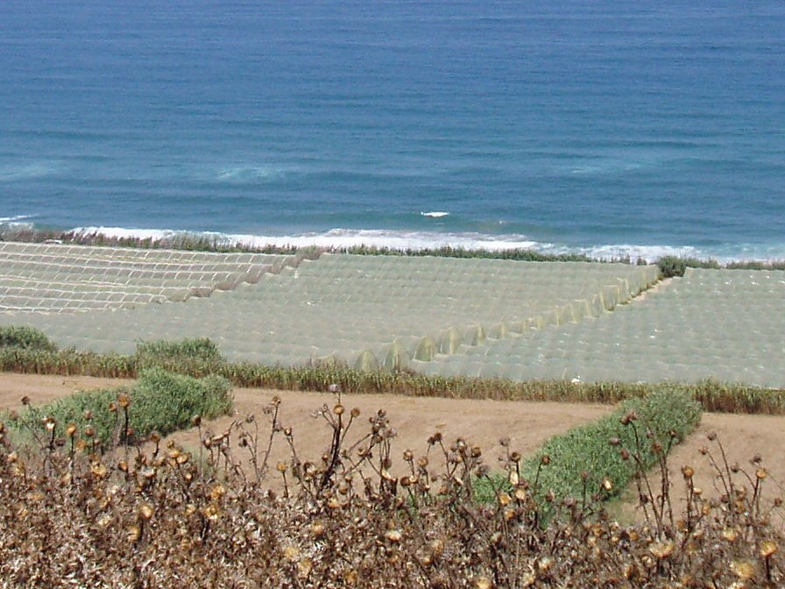
Erasmus+ Mundus
Joint MSc Programme
Groundwater and Global Change
Impacts and
Adaptation
(Acronym GroundwatCh)

Slide 15
Full partners
Delft, the Netherlands
Hydro(geo)logical research, education and capacity building across the globe
Lisbon, Portugal
Integrated water resources management perspective
Large experience on EU Water Framework Directive implementation
Groundwater Research Centre in semi-arid hydrogeology
Dresden, Germany
Renowned expertise in the field of climate and hydrology
Well-matched combination of engineering, geo and natural sciences

Slide 16
Scope of GroundwatCh
Groundwater mostly an invisible resource: overexploitation as well as underexploitation
Management of groundwater resources challenging: can only be improved by an increased study and understanding
Important aquifer-soil-atmosphere feedback mechanisms
Global changes largely affect groundwater resources:
  depletion
  seawater intrusion
  contamination
  reduction in base flows in rivers
  land subsidence
Groundwater plays an important role in adaptation:
  high storage capacity
  high resilience
  fossil groundwater
Notes:
Global changes: increasing population, shift in habits, economic development, all leading to increasing water demand
Climate change:

Slide 17
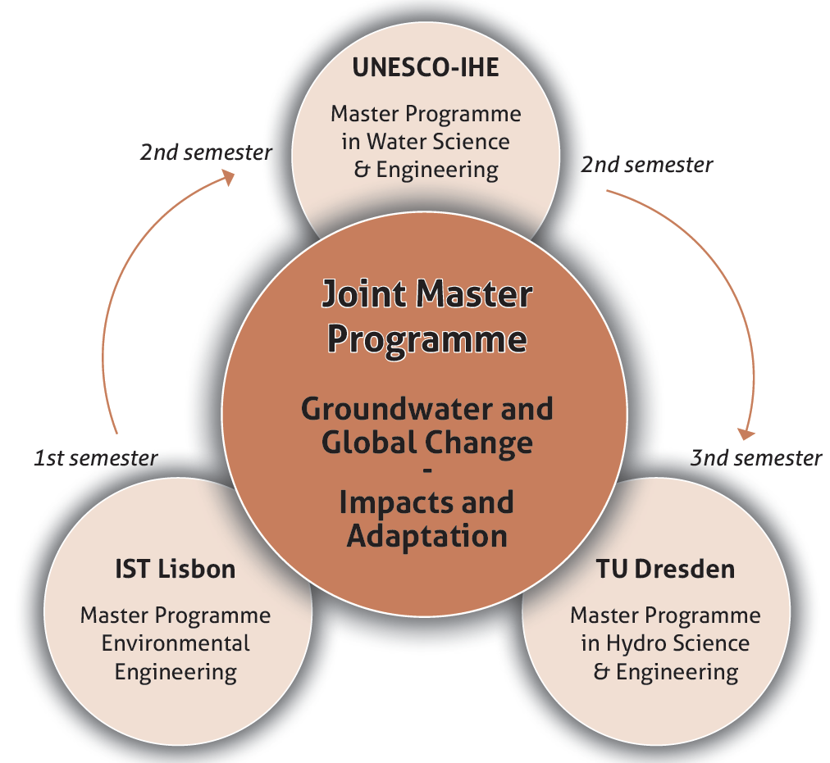
Mobility track
4th semester
MSc thesis: research phase at one of the
full partners, in collaboration with associated partners

Slide 18
DECivil
PhD Degrees
Architecture
Civil engineering
Climate changes and sustainable development policies
Geo-resources
Petroleum engineering
River restoration and management
Territory engineering
Transport systems
FCT funded PhD programs in Civil Engineering
Analysis and Mitigation of Risks in Infrastructures
Environmental Hydraulics and Hydrology
Eco-Construction and Rehabilitation

Slide 19
DECivil
Rankings 2016 / 2017
CIVIL ENGINEERING
SHANGHAI (ARWU) TAIWAN
1st / 1st Portugal 1st Portugal
13th / 7th Europe 6th Europe
34th / 43rd World 28th World

Slide 20
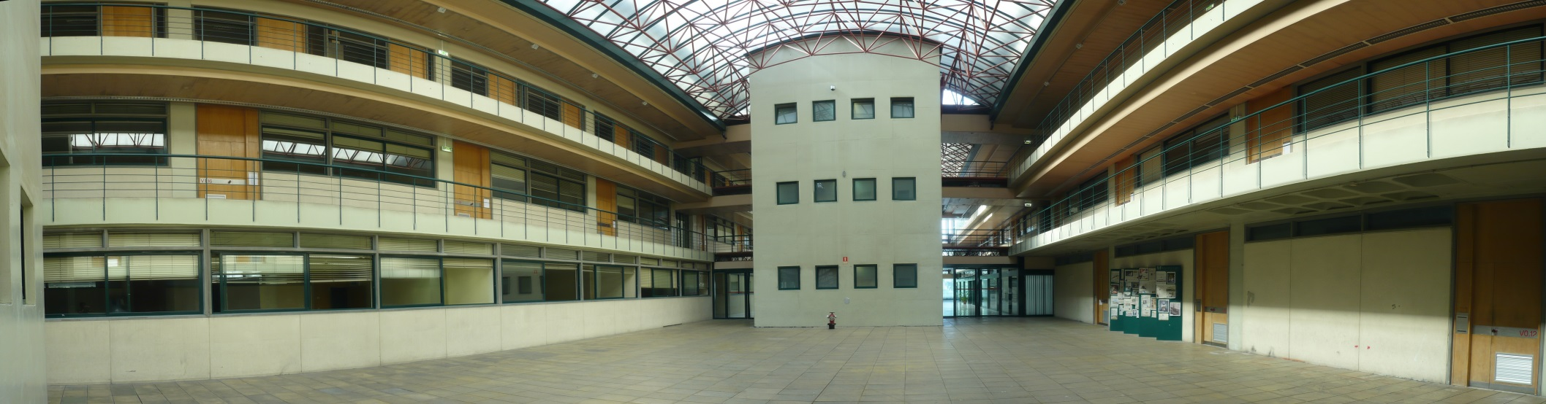
RESEARCH UNITS
Presently, DECivil hosts two research units:
CERIS, the merge of CEHIDRO-CVRM, CESUR and ICIST, with 7 groups, 129 PhD members, 302 PhD students, 8 laboratories and 13 administrative staff members.
CERENA - Natural Resources and Environment Centre, with 3 groups (Energy, Environment and Raw Materials) and 50 PhD members (mostly from Mining Engineering).

Slide 21

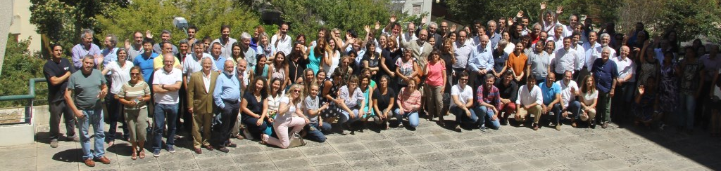
DECivil
Research Units - CERIS
At the end of 2016, CERIS staff comprised:
129 PhD members;
89 PhD collaborators;
258 non-PhD researchers (PhD students enrolled at IST and project grant holders);
8 laboratory staff members;
13 administrative staff.

Slide 22
CERIS | ISI/SCOPUS Journal Papers
Average increase rate | 24 per year

Slide 23
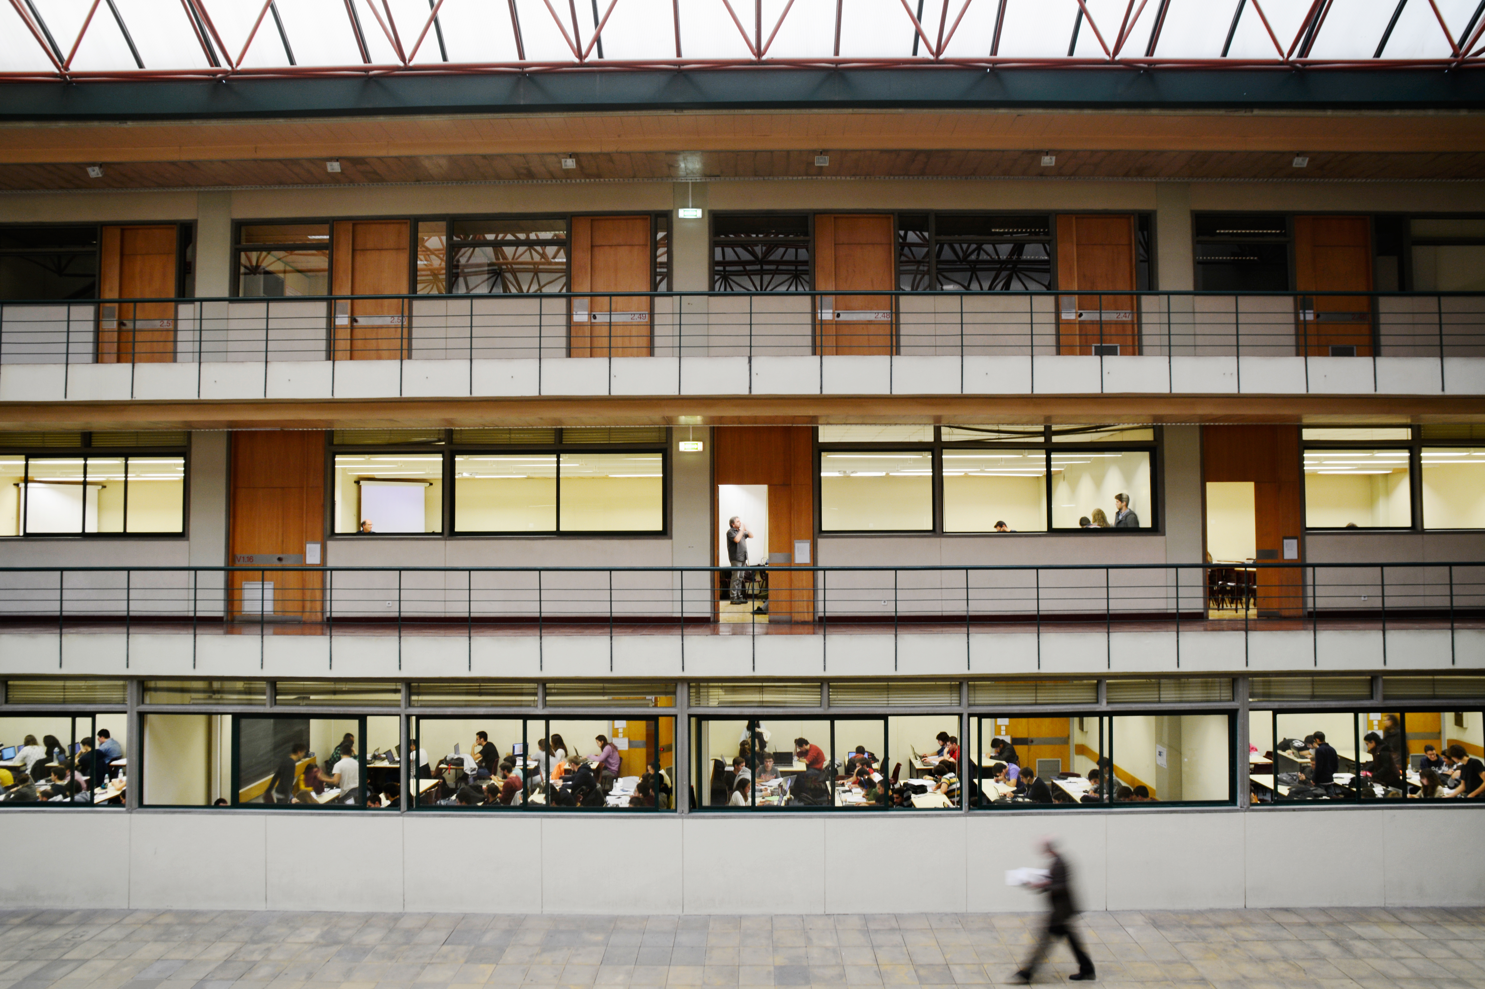
OVERVIEW OF CERIS
2

Slide 24
RESEARCH GROUPS (7)
RG1 Structures and Geotechnics
RG2 Studies on Construction
RG3 Transportation Systems
RG4 Systems and Management
RG5 Hydraulics
RG6 Environment and Water Resources
RG7 Architecture, Urbanism and Territory
Large unit: stability / flexibility (Same chassis / different models)
ICIST
CESUR
CEHIDRO
CAUT

Slide 25
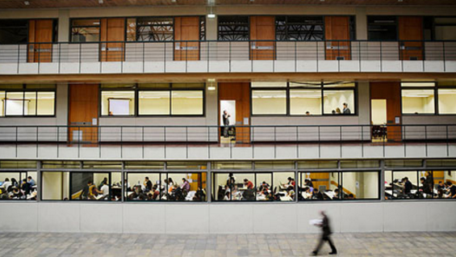
LABORATORY FACILITIES
3

Slide 26
LABORATORIES (8)
ISTAR | LABORATORY OF ARCHITECTURE
LC | LABORATORY OF CONSTRUCTION
LERM | LABORATORY OF STRUCTURES AND STRENGTH OF MATERIALS
LA | LABORATORY OF ENVIRONMENT
LH | LABORATORY OF HYDRAULICS
LG | LABORATORY OF GEOTECHNICS
LVCT | LABORATORY OF TRANSPORT INFRASTRUCTURES
LMC | COMPUTATIONAL MECHANICS LABORATORY

Slide 27
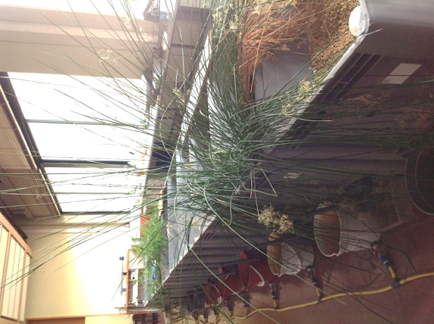
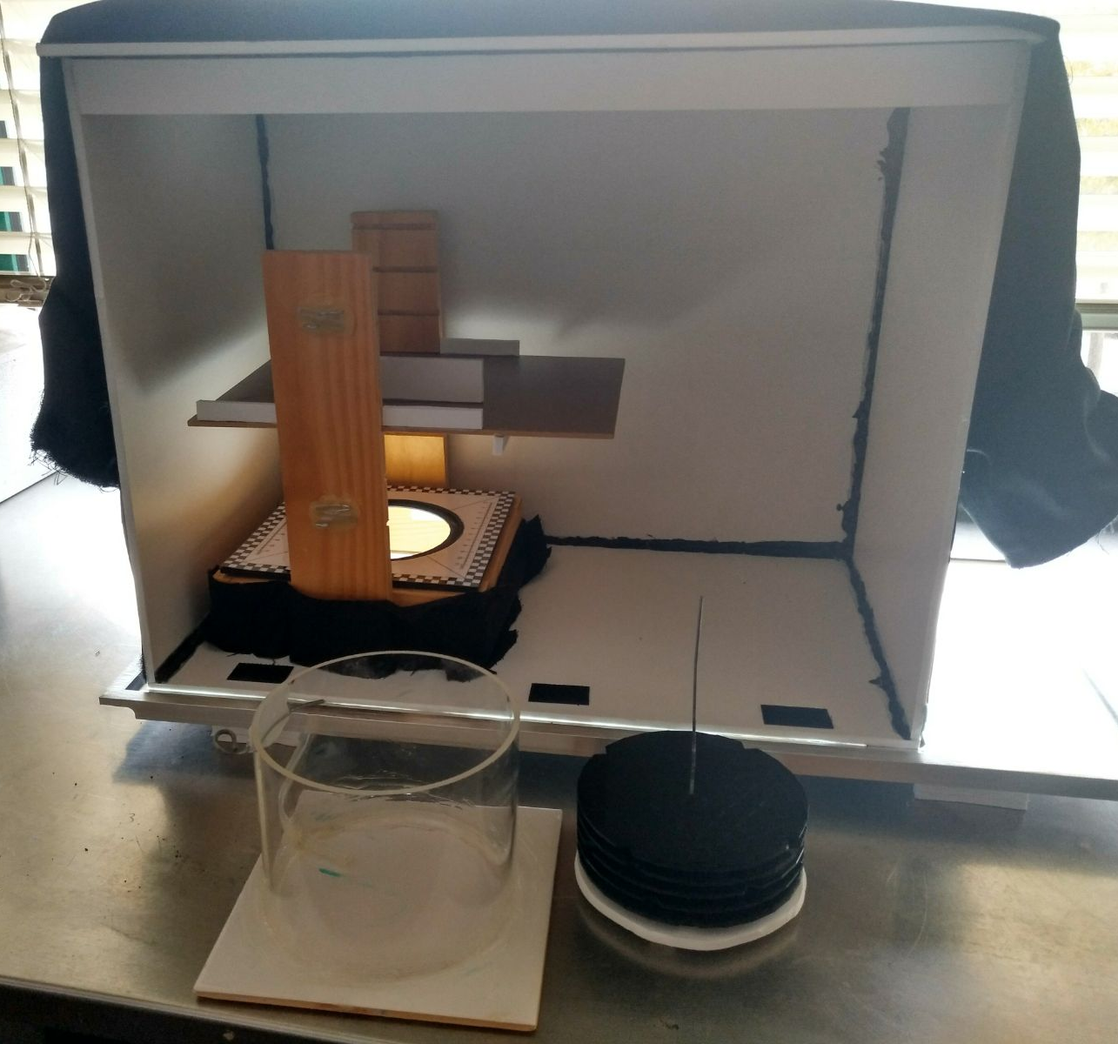
LABORATORIES (8)
LA | LABORATORY OF ENVIRONMENT
LA provides support for teaching, research & development and consultancy activities in the fields of Environmental Engineering and Hydrogeology. LA is equipped with a wide range of technical equipment for water, soil and biological analysis and field data monitoring.
Wood box for image acquisition and biofilm reactors
Constructed wetlands beds

Slide 28
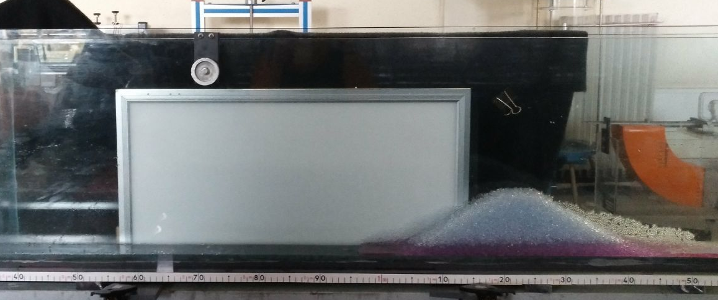
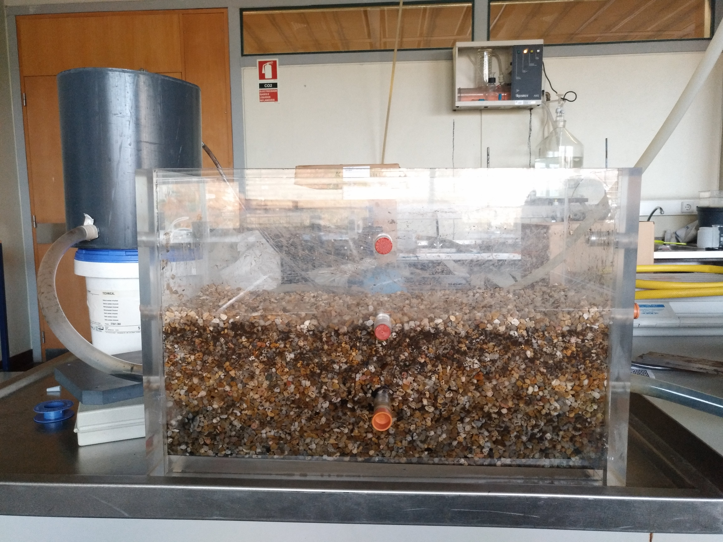
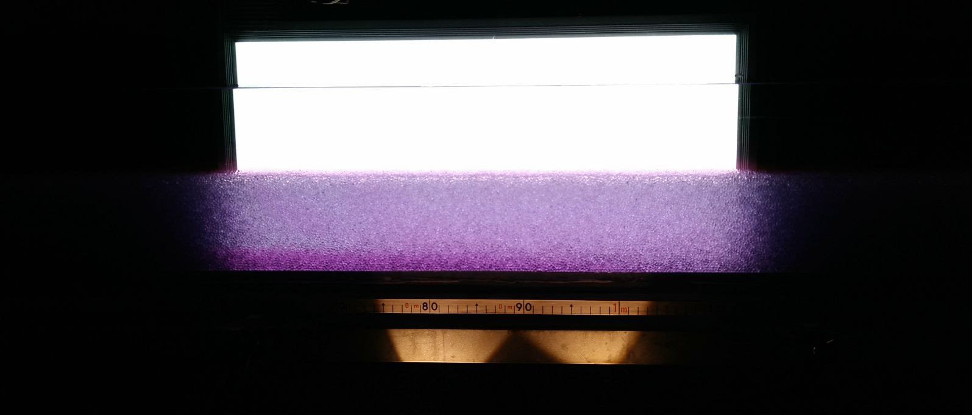
LABORATORIES (8)
LA | LABORATORY OF ENVIRONMENT
LA provides support for teaching, research & development and consultancy activities in the fields of Environmental Engineering and Hydrogeology. LA is equipped with a wide range of technical equipment for water, soil and biological analysis and field data monitoring.
Open channel for density current studies
Gravel respirometer

Slide 29
LABORATORIES (8)
LA | LABORATORY OF ENVIRONMENT
LA provides support for teaching, research & development and consultancy activities in the fields of Environmental Engineering and Hydrogeology. LA is equipped with a wide range of technical equipment for water, soil and biological analysis and field data monitoring.
RESEARCH & DEVELOPMENT
Clogging process in constructed wetlands
Respirometry
Sulphyde release on drop manholes
Support to field measurements based on probes
Biofilm growth measurement
Current density analysis in porous media
CONSULTANCY ACTIVITIES
Evaluating Infiltration Inflows in the Alcântara sewer system
Evaluation of surface and groundwater quality in Parques de Sintra-Monte LUA

Slide 30
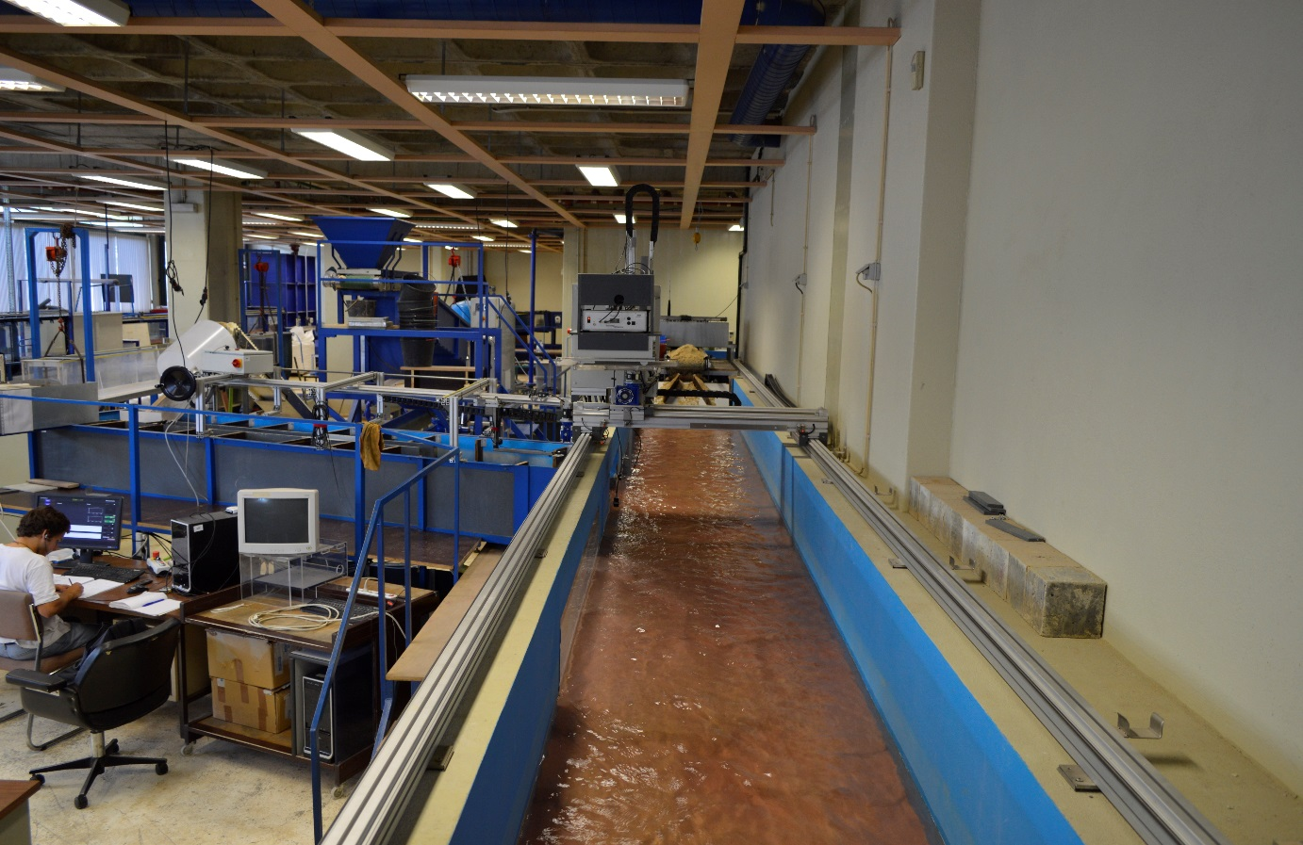
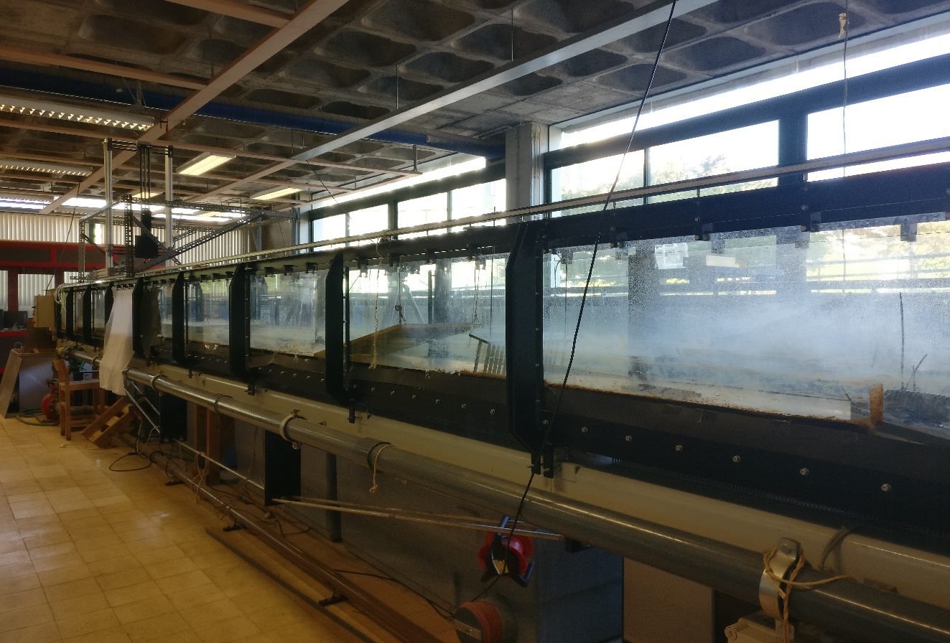
LABORATORIES (8)
LH | LABORATORY OF HYDRAULICS
LH is used for teaching, research & development and consultancy in the field Hydraulics. LH has several experimental facilities and test-rigs, fully equipped with a state-of-the-art instrumentation to undertake lab or field studies
Morphodynamics of river confluences | Flume
Mechanics of granular media in 3D turbulent flows | Flume

Slide 31
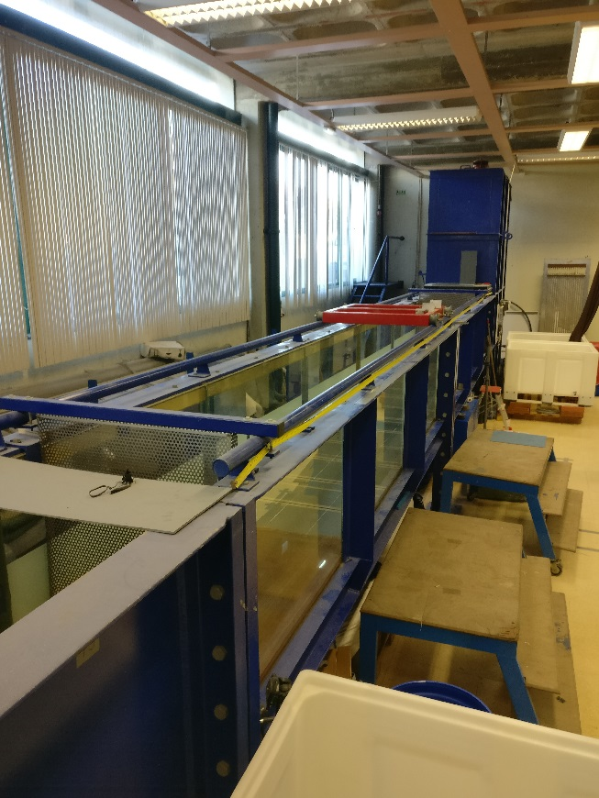
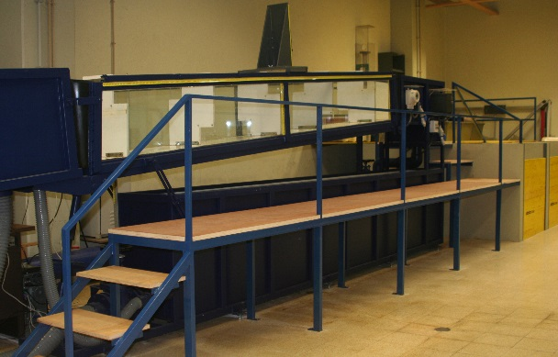
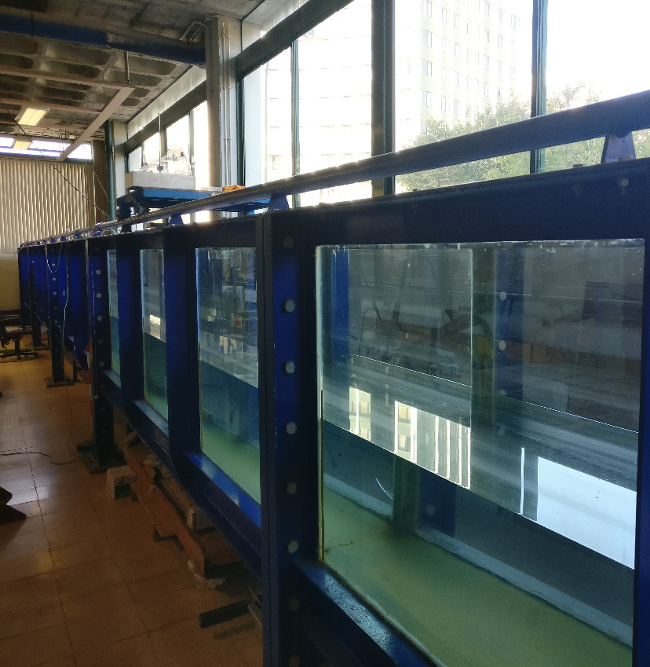
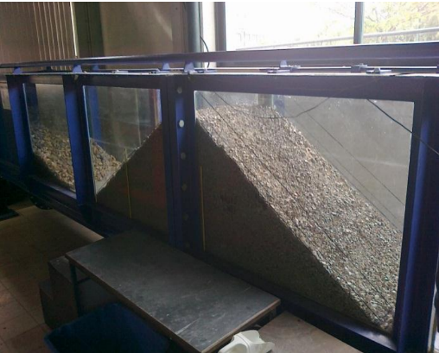
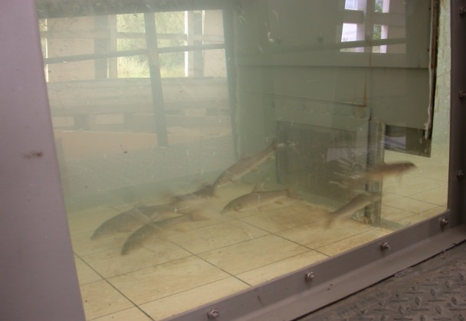
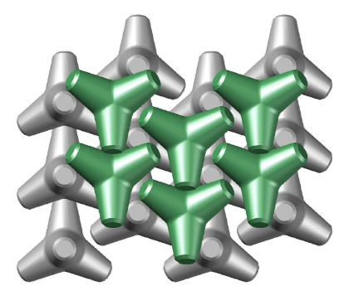
LABORATORIES (8)
LH | LABORATORY OF HYDRAULICS
LH is used for teaching, research & development and consultancy in the field Hydraulics. LH has several experimental facilities and test-rigs, fully equipped with a state-of-the-art instrumentation to undertake lab or field studies
Pool-type fishways | Flume
Armor blocks stability on rubble mound breakwater | Flume

Slide 32
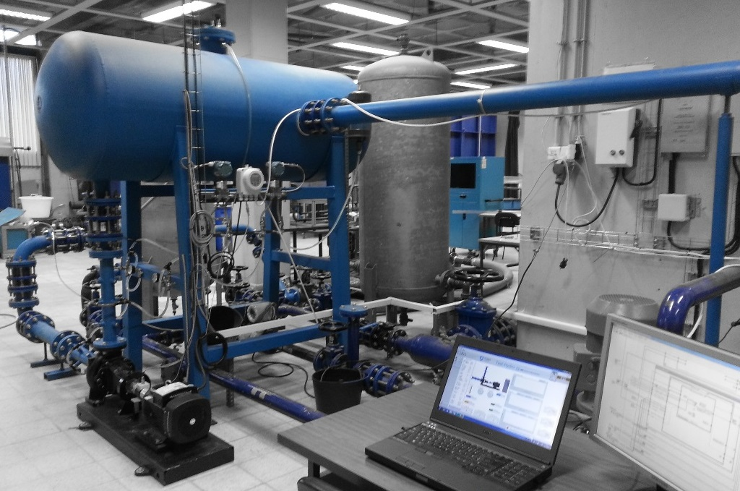
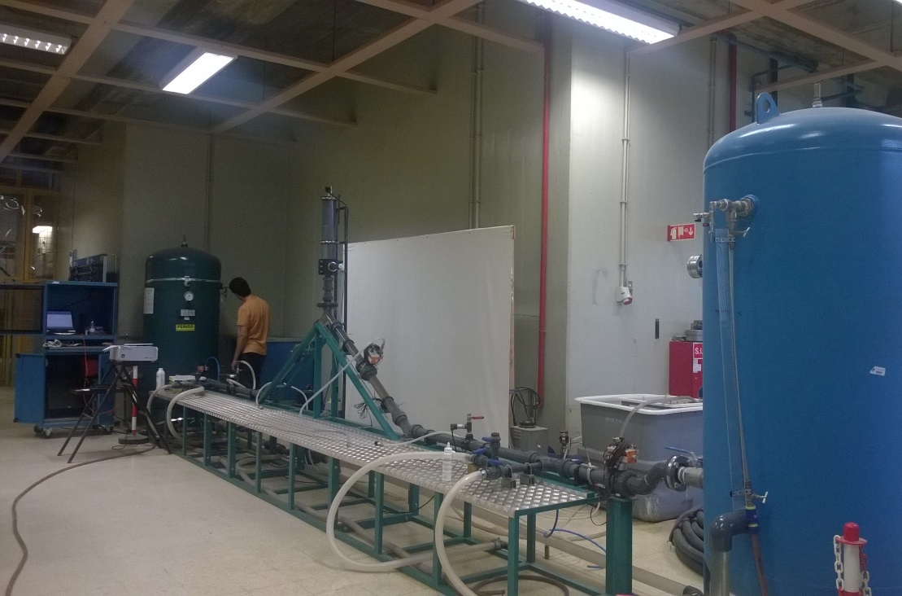
LABORATORIES (8)
LH | LABORATORY OF HYDRAULICS
LH is used for teaching, research & development and consultancy in the field Hydraulics. LH has several experimental facilities and test-rigs, fully equipped with a state-of-the-art instrumentation to undertake lab or field studies
Small power turbomachines | Test-Rig
Waterhammer and pipe filling | Test-Rig

Slide 33
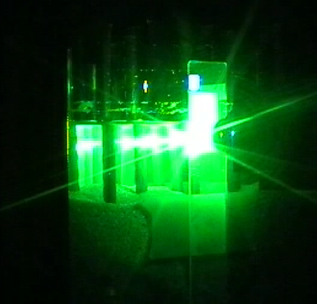
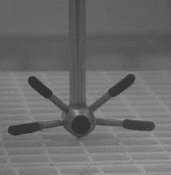
LABORATORIES (8)
LH | LABORATORY OF HYDRAULICS
LH is used for teaching, research & development and consultancy in the field Hydraulics. LH has several experimental facilities and test-rigs, fully equipped with a state-of-the-art instrumentation to undertake lab or field studies
Main Equipment |
Particle Image Velocimeter (PIV)
Acoustic Doppler Velocimeters (ADV)
Ultrasonic Velocity Profilers (UVP)
Electromagnetic and Ultrasonic Flowmeters
Pressure and strain gauges
Limnimeters (resistive probes, echo-sounders)
Bed followers (laser; micro-echo-sounders)
PIV
ADV

Slide 34
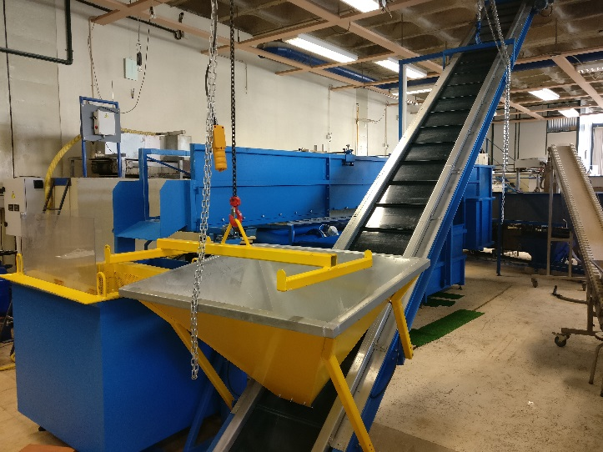
LABORATORIES (8)
LH | LABORATORY OF HYDRAULICS
LH is used for teaching, research & development and consultancy in the field Hydraulics. LH has several experimental facilities and test-rigs fully equipped with a state-of-the-art instrumentation to undertake lab or field studies
RESEARCH & DEVELOPMENT
Fluid-structure interaction
Hydropower and efficiency
Local scour at complex bridge piers
Innovative pool-type fishways design
Hydropeaking on the behavior of cyprinids
Armor blocks stability on breakwater
Morphodynamics of river confluences
Mechanics of granular media in 3D turbulent flows
CONSULTANCY ACTIVITIES
Small power hydraulic turbomachines testing
Slit check-dams for the mitigation of debris flows in Madeira Island

Slide 35
SOURCES OF FUNDING
4

Slide 36


BUDGET SOURCES
Foundation for Science and Technology
  Strategic Funding:
    Dependent on the FCT grading
  National Competition for PhD and Post-Doc Scholarships:
  Annual calls
  National Competition for Research Projects in all Scientific Domains:
  Non-periodic calls
National Innovation Agency (ANI)
  Different funding sources open to universities, e.g.:
  Co-promotion Projects (led by companies, direct funding to universities);
  Innovation Check (funding through companies).

Slide 37

BUDGET SOURCES
European Union (H2020)
  Calls strongly related with societal changes, not with ‘hard’ civil engineering issues.
  Marie Curie scholarships
  Etc.
Industry
  There was never a strong tradition of Portuguese companies to invest in R&D.
  Funding mostly targeted specific, immediate needs, as opposed to support of long-term development strategies.
  In spite of the economic crisis, which was particularly acute in the construction sector, industry funding did not fall as sharply as expected and signs of recovery were visible in 2016.

Slide 38
HIGHLIGHTS OF RESEARCH ACTIVITY
RESEARCH GROUPS
6

Slide 39
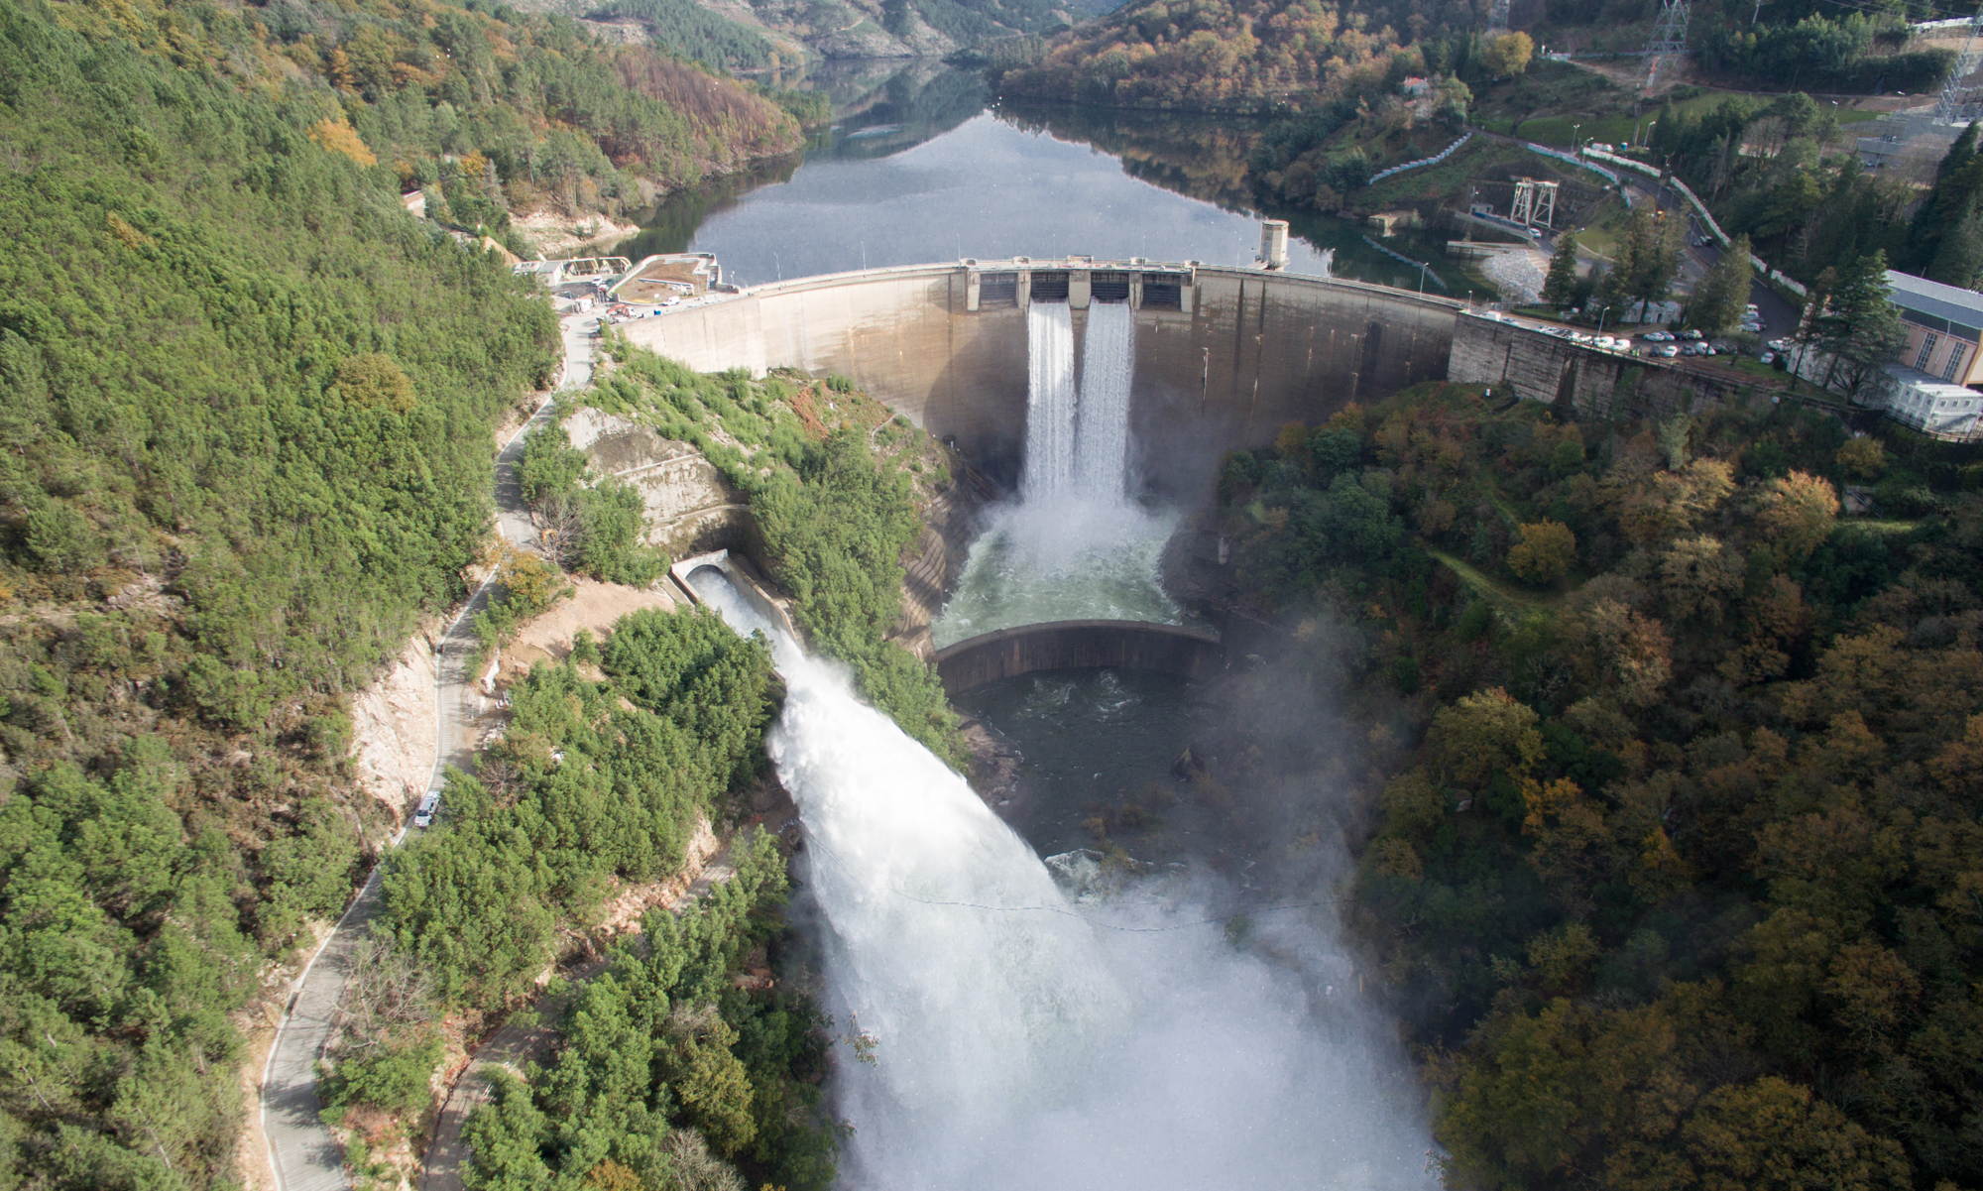
RG5 – HYDRAULICS
6.5

Slide 40
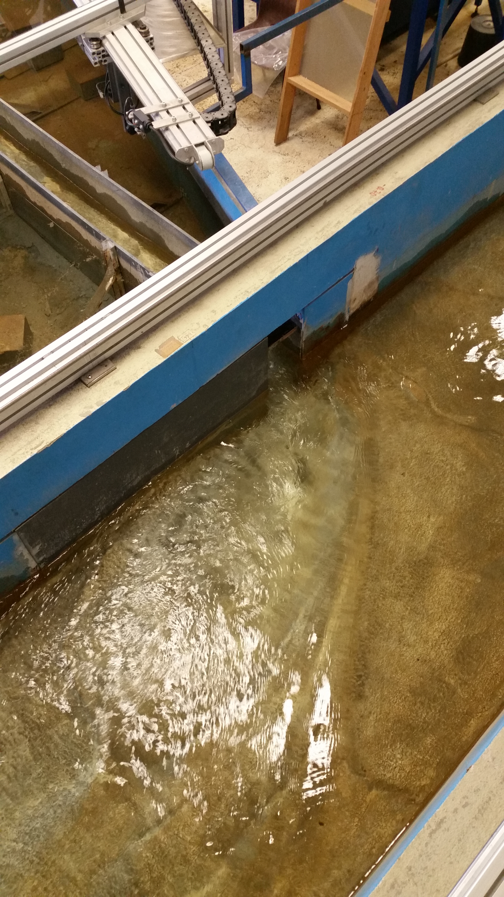
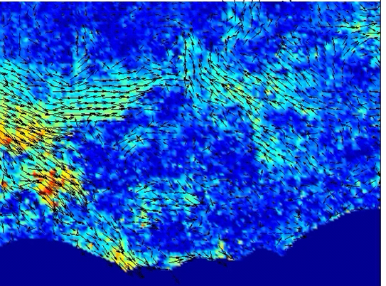
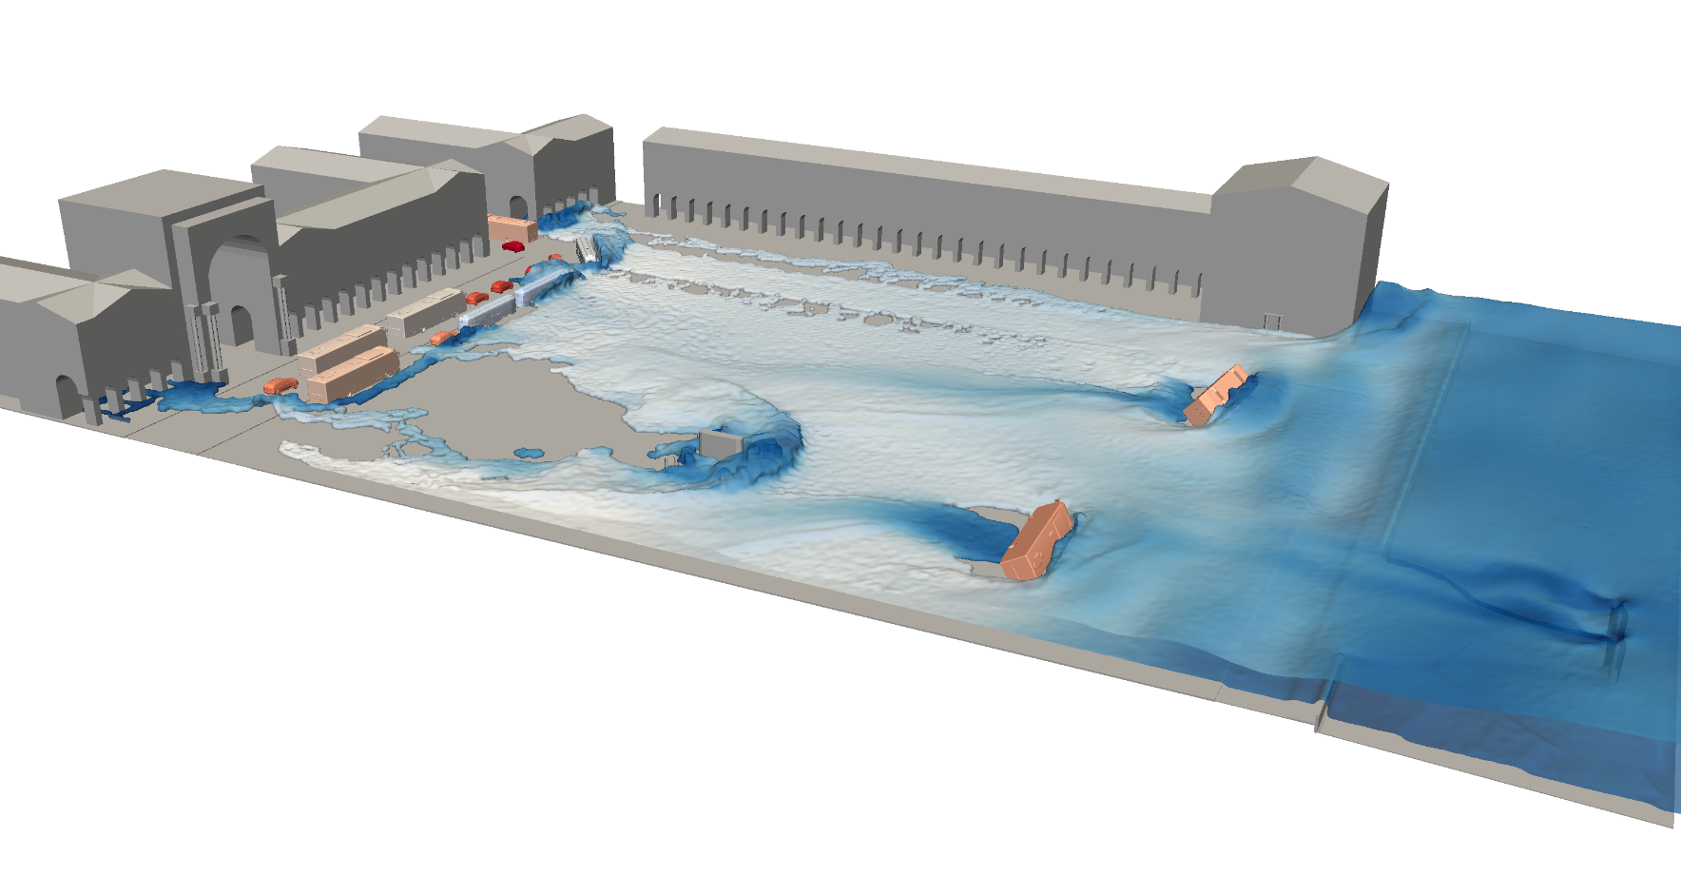
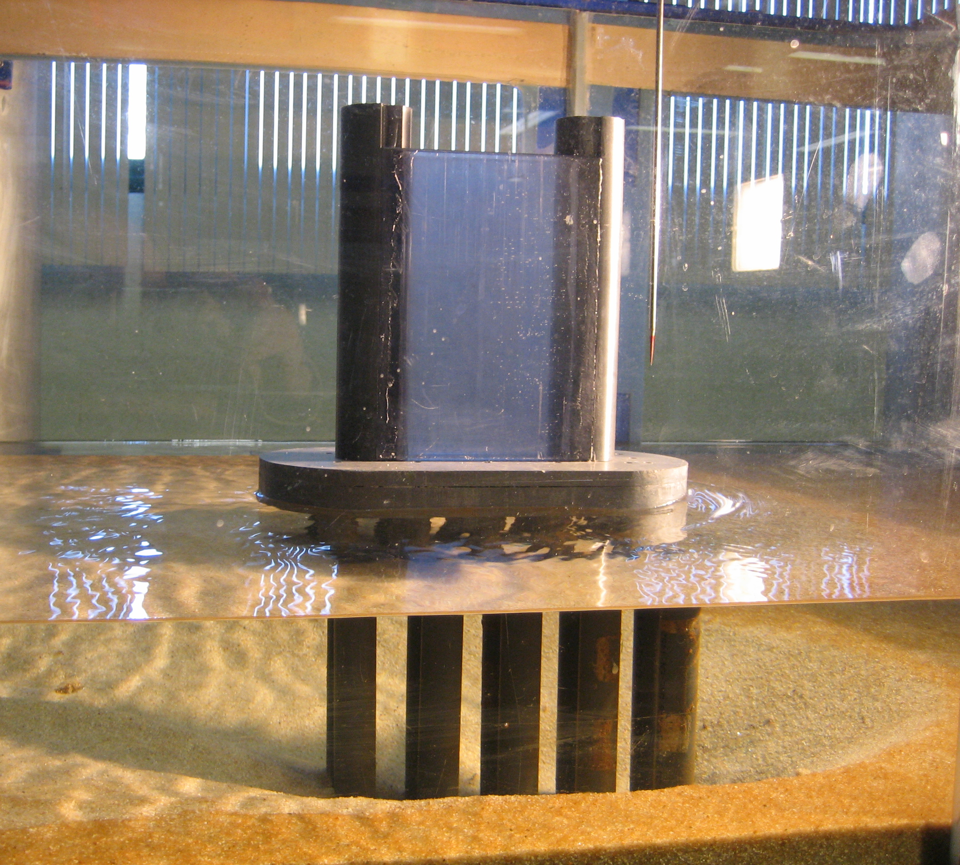
Research Topics
1. COMPUTATIONAL FLUID DYNAMICS, CFD, MODELLING OF HYDRAULIC CIRCUITS, STRUCTURES AND FISH PASSES
2. DAM-BREAK FLOWS AND OVERLAND TSUNAMI PROPAGATION
3. MORPHODYNAMICS OF RIVER CONFLUENCES AND SCOURING AROUND BRIDGE PIERS
4. TURBULENCE IN VEGETATED CHANNELS

Slide 41
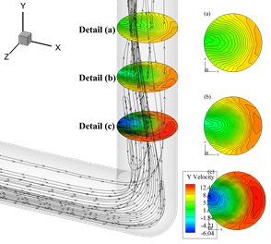
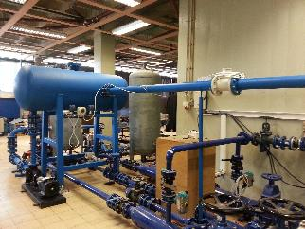


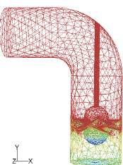
Research Topics
5. HYDRODYNAMIC AND SAFETY ANALYSIS OF PRESSURIZED PIPE SYSTEMS
6. PUMP, HYDROPOWER AND PUMPED-STORAGE SYSTEMS
7. HYDRAULICS AND AERATION ALONG STEPPED SPILLWAYS AND CASCADE DROPS
8. FISH BEHAVIOUR ASSESSMENT IN POOL-TYPE FISHWAYS AND UNDER HYDROPEAKING REGIMES

Slide 42
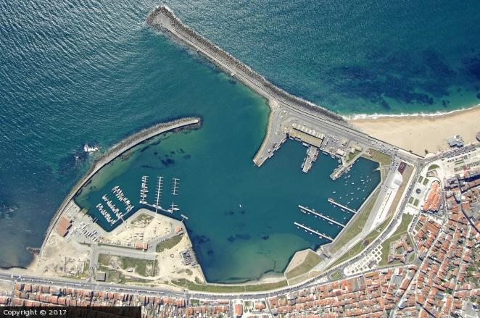
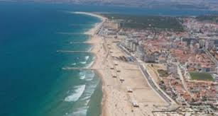
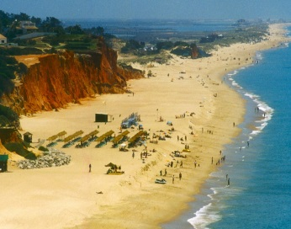
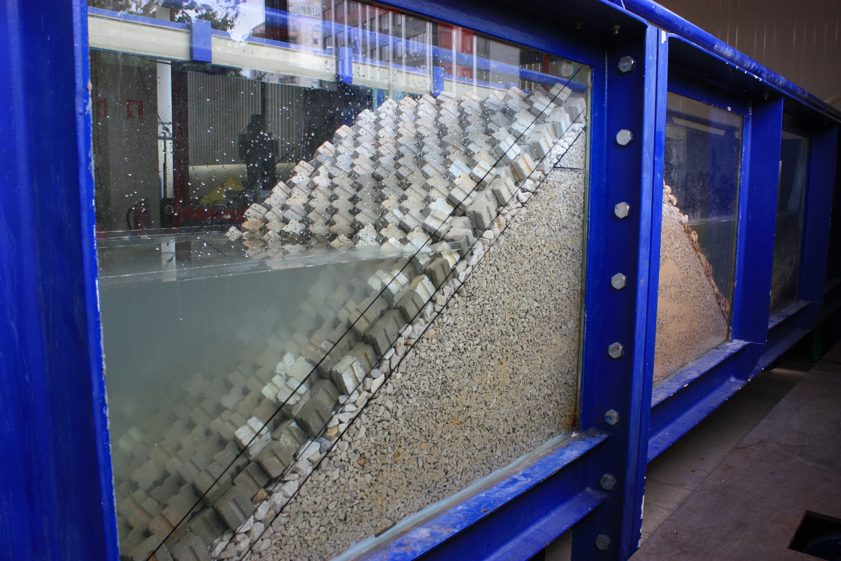
Research Topics
9. MODELLING OF EXTREME EVENTS NEAR THE COAST AND SHORELINE EVOLUTION
10. RESIDUAL AGITATION INSIDE HARBOURS
11. WIND-WAVE MODELLING AND COASTAL MORPHODYNAMICS

Slide 43
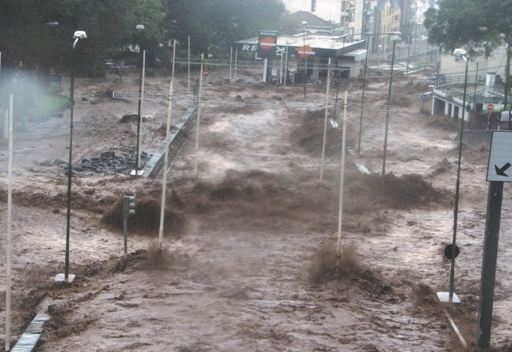
RG6 – Environment and Water Resources
6.6

Slide 44
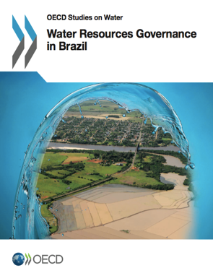
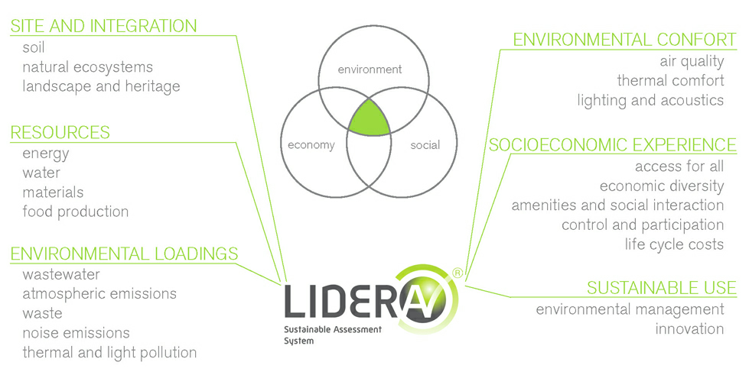
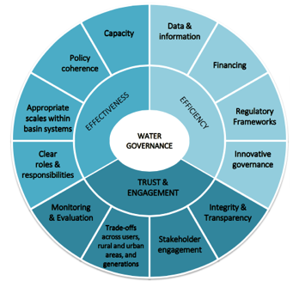
Research Topics – Environment and Water Services
1. SUSTAINABLE ASSESSMENT, DESIGN AND MANAGEMENT OF NATURAL AND BUILT ENVIRONMENTS
2. WATER POLICY FORMULATION AND GOVERNANCE
3. INTEGRATED WATER RESOURCES MANAGEMENT

Slide 45
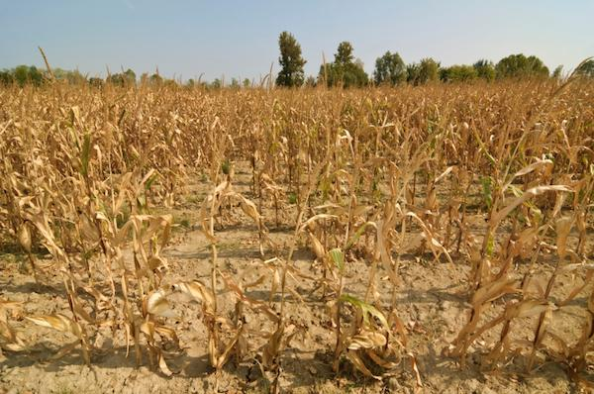
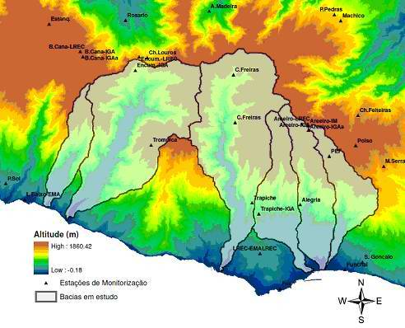
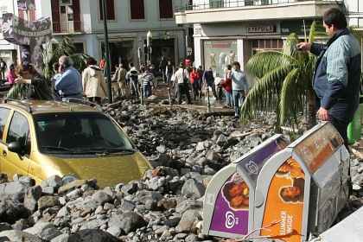
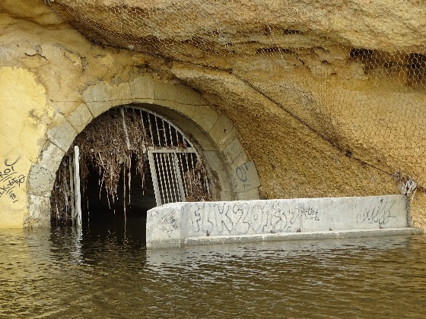
Research Topics – Environment and Water Services
4. HYDROLOGIC PROCESSES MONITORING AND MODELLING
5. CLIMATE CHANGE IMPACTS ASSESSMENT ON NATURAL AND MAN-MADE WATER SYSTEMS AND ADAPTATION STRATEGIES
6. WATER ASSET MANAGEMENT

Slide 46
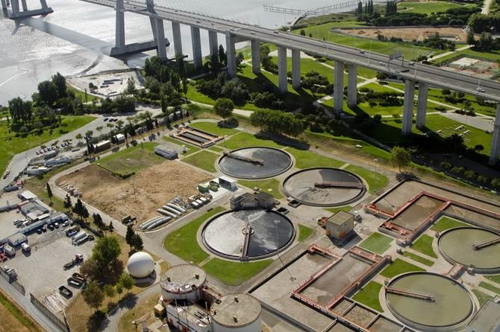



Research Topics – Environment and Water Services
7. DYNAMIC MODELLING OF TREATMENT OPERATIONS AND SEWER PROCESSES
8. NATURE BASED SOLUTIONS AND WATER AND SANITATION SERVICES
9. WATER SUPPLY AND SANITATION OF PERI-URBAN AREAS OF LOW INCOME COUNTRIES

Slide 47


Research Topics – Hydrogeology and Geosystems
1. GROUNDWATER POLLUTION AND RISK ASSESSMENT
2. GROUND WATER AND ECOSYSTEMS
3. STOCHASTIC AND DETERMINISTIC GROUND WATER MODELLING
4. GROUNDWATER AND GLOBAL CHANGE

Slide 48








Research Topics – Hydrogeology and Geosystems
4. URBAN HYDROGEOLOGY
5. DEVELOPMENT OF EFFECTIVE METHODS FOR RISK-BASED ENVIRONMENTAL DECISION-MAKING UNDER UNCERTAINTY
6. DECISION SUPPORT SYSTEMS FOR WATER CATCHMENT MANAGEMENT
7. LIFE CYCLE ASSESSMENT, LCA, OF SOIL AND GROUNDWATER REMEDIATION WITH THE DEVELOPMENT OF TOOLS BRINGING SOIL AND GROUNDWATER IMPACTS INTO LCA

Slide 49
SOME INDICATORS: PhD PROGRAMS
CERIS leads 4 out of 5 FCT funded PhD programs in the Civil Engineering area:
DPTS - Transportation Systems (IST-MIT, since 2007)
H2Doc - Environmental Hydraulics and Hydrology (IST-EPFL, since 2008)
Eco-Core - Eco Construction and Rehabilitation (since 2013)
InfraRisk⁻ - Analysis and Mitigation of Risks in Infrastructures (since 2013)
CERIS also participates in 2 other FCT funded PhD programs:
FLUVIO - River Restoration and Management (UPM, UFB, ECK, Katopodis EH, since 2013)
PDSCPDS - Climate Change and Sustainable Development (since 2014)
CERIS also coordinates or participates in 8 PhD and 11 MSc programs promoted by IST-UL (not funded by FCT).

Slide 50


SOME INDICATORS: PhD THESES & MSc DISSERTATIONS
Concluded PhD theses
Concluded MSc dissertations
2016
2016
0.31 / PhD member
2.22 / PhD member

Slide 51
SOME INDICATORS: JOURNAL PAPERS
Papers published in ISI (& Scopus) journals
2016
2.10 / PhD member

Slide 52


SOME INDICATORS: JOURNAL PAPERS
Publication in ISI/Scopus journals per PhD researcher
Publication in ISI/Scopus journals per PhD member

Slide 53
SOME INDICATORS: JOURNAL PAPERS
Distribution of papers published in ISI journals per quartile (Q1 to Q4) of impact factor

Slide 54


SOME INDICATORS: CONFERENCE PAPERS
Papers published in proceedings of international conferences
Papers published in proceedings of national conferences
2016
2016
2.22 / PhD member
1.53 / PhD member

Slide 55



SOME INDICATORS: FUNDING
Annual funding per research unit (research and consultancy)
CERIS annual funding in research and consultancy
Average values in 2013-2015
Consultancy: 1622 k€/year (~59%)
R&D projects: 1150 k€/year (~41%)
Total: 15k€/year/PhD researcher
Total: 23k€/year/PhD researcher
Total annual funding per PhD researcher and per PhD member

Slide 56


























































































Slide 57



IST
LISBOA

